Slide 1
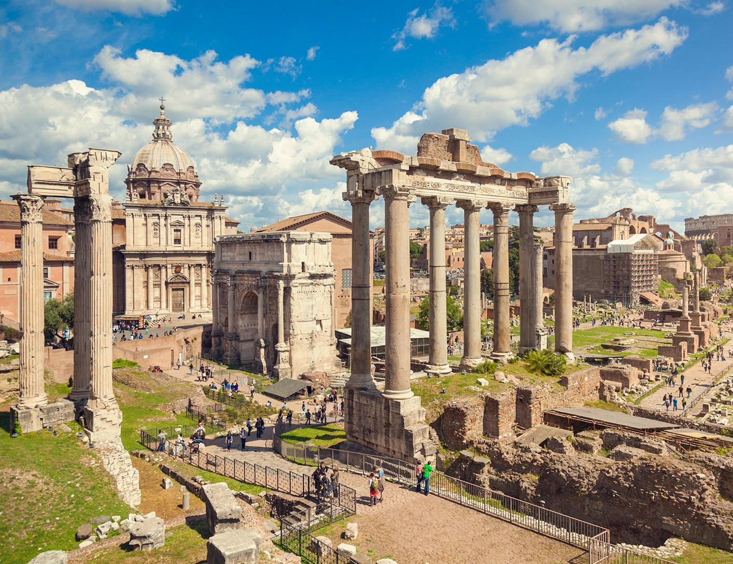
Ancient Rome STRUCTURES
- Identify the social, political, economic, and military structures of Ancient Rome
Week 4 Lesson 1
Ms Barrie

Slide 2
ACTIVITY – ‘One Pager’
Using an A3 piece of paper, create a mindmap or 4-section ‘One Pager’ about the
Social, political, economic, and military structures of Ancient Rome
Notes:
Teacher draws sample structures

Slide 3
Social Structure
Social classes - hierarchy
Status of freeborn Romans during the Republic was established by:
Ancestry (patrician or plebeian)
Census rank (ordo) based on wealth and political privilege, with the senatorial and equestrian ranks elevated above the ordinary citizen
Gender
Citizenship, of which there were grades with varying rights and privileges.
Classes – different rights and privileges, including voting rights, and marriage rights
Patricians were considered the upper class in early Roman society. They controlled the best land and made up the majority of the Roman senate.
Plebeians were the lower class of Rome, laborers and farmers who mostly worked land owned by the patricians.

Slide 4
Social Structure
The Emperor The Emperor was the head of Roman society and ruler of all Rome
Patrician Families Wealthy influential landowning families
Senators In roman society, they served in the Senate and governed Rome
Equestrians Wealthy property owners who chose business over politics in Roman society
Plebeians Working class men without substantial wealth who worked for their living at jobs such as artisans, craftsmen, bakers etc
Freed Slaves Slaves who had either been given their freedom or had paid for their freedom and now worked for their living.
Slaves Generally prisoners of war but sometimes abandoned children who were owned by their master.

Slide 5
Political Structure
Had constitution and detailed laws
TRIPARTITE GOVERNMENT: 3 parts = a system of checks and balances to stop any 1 part from getting too much power
TOP of Roman government: two leaders called consuls.
Patricians who were partly in charge of the government (serve for 1 year)
One consul headed the army, one headed the government
Notes:
. So that one consul did not take too much power and become too much like a king or a dictator, each consul could veto, or reject, the other consul’s decision. “Veto” means “ I forbid” in Latin.

Slide 6
Political Structure
Two Legislative (law-making) bodies
The Senate: 300 non-elected patrician men, appointed by the consuls.
Position for life
Advised consuls, passed laws/building projects
The Assembly: Plebeians who could vote on laws, but the Senate could block their votes.
Had limited power BUT every year they were allowed to vote on which two Roman senators would serve as consuls

Slide 7
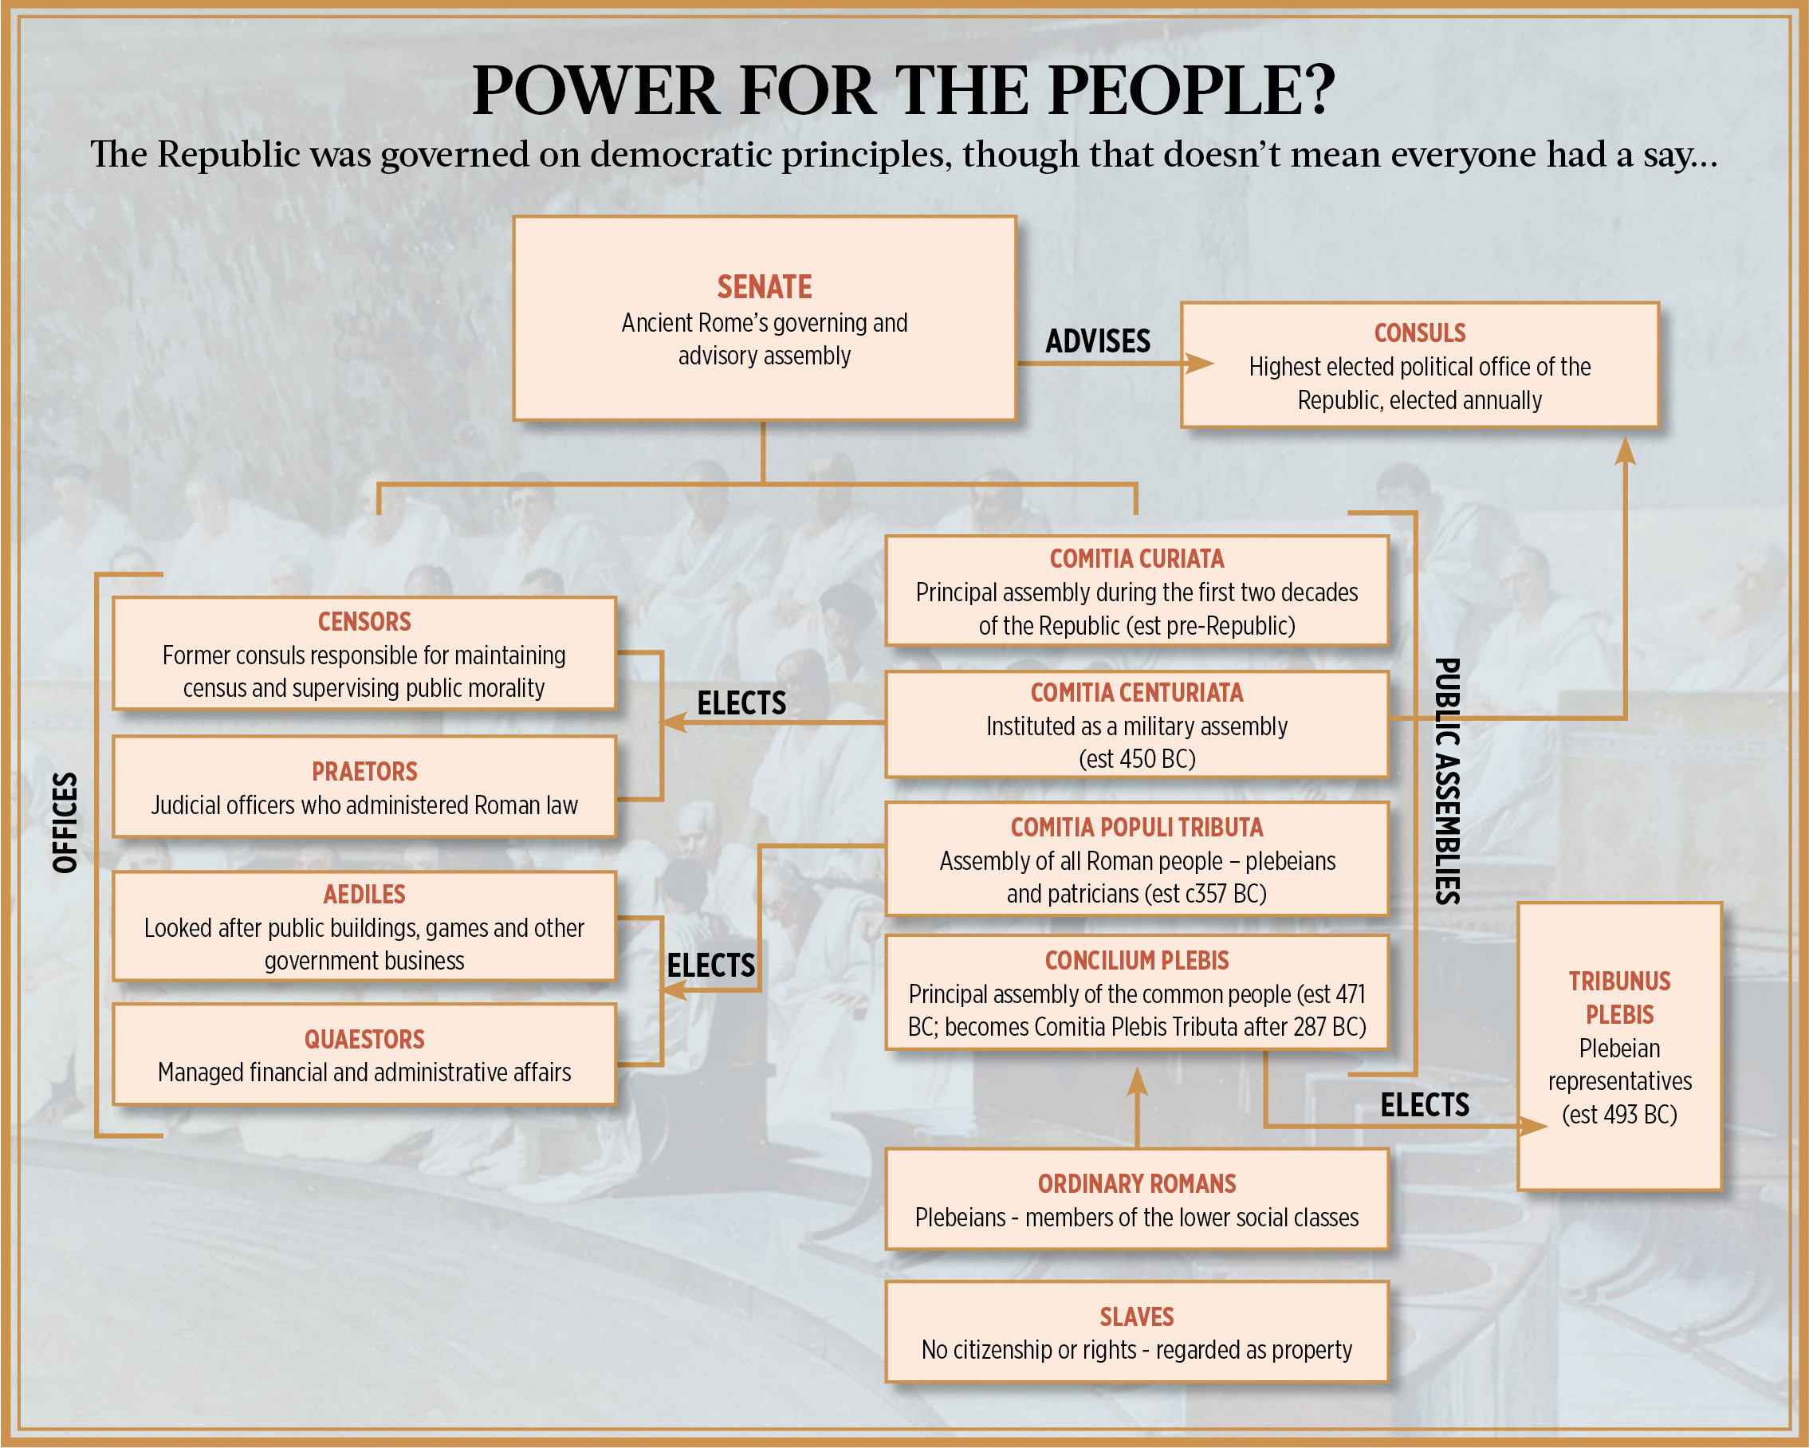

Slide 8
Economic Structure
https://www.youtube.com/watch?v=OBfag9O8jCw&ab_channel=Instructomania

Slide 9
Economic Structure
Agrarian and slave-based
Staple crops were grains, olives, and grapes - olive oil and wine led Italy's exports
Farmers could donate surplus crops to the government to pay their taxes.
Vast exchange of other goods from all parts of Europe, Asia, and Africa
Industry and manufacturing were secondary to agriculture
Mining – stones, marble, gold, silver, iron, lead, tin
Extensive trade routes were established on land (roads) and sea
Romans used one of the world's most developed coinage systems (brass, bronze, copper, silver, and gold)

Slide 10
Military Structure
created and controlled by its soldiers
core of the army were = legions
Elite training, discipline and fighting ability
Augustus = 60 legions
divided into ten cohorts of up to 480 men
minimum term of service for a soldier during the first century AD was twenty years.

Slide 11
Military Structure
Each legionnaire (or 'miles') carried a short sword, called a gladius= main weapon.
He also carried a 'pilum' (javelin), a helmet, armor, shield and a pack with supplies.
Soldiers were rigorously trained to march long distances, fight in precise formations, and kill expertly with all the weapons they carried.
The toughest postings for soldiers were those at the frontiers of the Roman Empire, where legionnaires never had enough supplies, faced hostile local tribes and had to endure tedious routines.
As future Emperors would discover, while soldiers were loyal to their emperor, this loyalty was nothing compared to the loyalty felt by many legions to their commanders.
Holding the monopoly on force that underpinned empire and emperor, the army was always politically important.
A discontented army was a powerful enemy and a popular commander was a potential threat.

Slide 12
Ancient Rome - Daily Life
https://www.youtube.com/watch?v=juWYhMoDTN0&ab_channel=TED-Ed

